Slide 1
Cyber-Attacks & SAP® Systems Is our business-critical infrastructure exposed?
Mariano Nunez
mnunez@onapsis.com
March 15th, 2012
BlackHat Europe 2012

Slide 2
Disclaimer
This publication is copyright 2012 Onapsis, Inc. – All rights reserved.
This publication contains references to the products of SAP AG. SAP, R/3, xApps, xApp, SAP NetWeaver, Duet, PartnerEdge, ByDesign, SAP Business ByDesign, and other SAP products and services mentioned herein are trademarks or registered trademarks of SAP AG in Germany and in several other countries all over the world.
Business Objects and the Business Objects logo, BusinessObjects, Crystal Reports, Crystal Decisions, Web Intelligence, Xcelsius and other Business Objects products and services mentioned herein are trademarks or registered trademarks of Business Objects in the United States and/or other countries.
SAP AG is neither the author nor the publisher of this publication and is not responsible for its content, and SAP Group shall not be liable for errors or omissions with respect to the materials.

Slide 3
Who is Onapsis, Inc.?
Company focused in the security of ERP systems and business-critical infrastructure (SAP®, Siebel®, Oracle® E-Business SuiteTM, PeopleSoft®, JD Edwards® …).
Working with Global Fortune-100 and large governmental organizations.
What does Onapsis do?
Innovative ERP security software (Onapsis X1, Onapsis Bizploit, Onapsis IA).
ERP security consulting services.
Trainings on business-critical infrastructure security.
Who am I?
Co-founder & CEO at Onapsis.
Discovered 50+ vulnerabilities in SAP, Microsoft, IBM, ...
Speaker/Trainer at BlackHat, RSA, HackerHalted, HITB, Ekoparty, DeepSec, ...
Developer of the first opensource SAP/ERP PenTesting frameworks.
Lead author of the “SAP Security In-Depth” publication.
Cyber-attacks on SAP systems
Cyber-attacks on SAP systems

Slide 4
Agenda
Introduction
A dangerous status-quo
External and internal threats
The current security level of SAP implementations
The TOP-11 vulnerabilities affecting the SAP infrastructure
Defending the SAP platform
Conclusions
Cyber-Attacks to SAP Systems
Cyber-attacks on SAP systems

Slide 5
Introduction
Cyber-attacks on SAP Systems

Slide 6
What is SAP?
Largest provider of business management solutions in the world.
More than 140.000 implementations around the globe.
More than 90.000 customers in 120 countries.
Used by Global Fortune-1000 companies, governmental organizations and defense agencies to run their every-day business processes.
Such as Revenue / Production / Expenditure business cycles.
FINANCIAL PLANNING
TREASURY
PAYROLL
INVOICING
LOGISTICS
SALES
BILLING
PROCUREMENT
PRODUCTION
Cyber-attacks on SAP Systems

Slide 7
A Business-Critical Infrastructure
ERP systems store and process the most critical business information in the Organization.
If the SAP platform is breached, an intruder would be able to perform different attacks such as:
ESPIONAGE: Obtain customers/vendors/human resources data, financial planning information, balances, profits, sales information, manufacturing recipes, etc.
SABOTAGE: Paralyze the operation of the organization by shutting down the SAP system, disrupting interfaces with other systems and deleting critical information, etc.
FRAUD: Modify financial information, tamper sales and purchase orders, create new vendors, modify vendor bank account numbers, etc.
Cyber-attacks on SAP Systems

Slide 8
A Dangerous
Status-quo
Cyber-attacks on SAP Systems

Slide 9
What “SAP Security” used to be 5 years ago
“SAP security” was regarded as a synonym of “Segregation of Duties controls”.
Sample goal: “Make sure that if Tim can create a new vendor, he can not create purchase orders”.
This was mapped to a SoD matrix with SAP transactions / authorization objects.
Most large organizations had “SAP Security” in place: they were spending hundreds of thousands/millions of dollars in SAP security yearly by having:
A dedicated team of SAP security professionals.
SoD & GRC software (usually costing $500K-$2M or more).
Cyber-attacks on SAP Systems

Slide 10
Breaking the status-quo / BlackHat 2007
The Information Security and Audit practices were doing fine with the reigning status quo. Most “SAP security”-related documents and guidelines only dealt with SoD issues.
One day, back in 2005, we were hired to do a Webapp pentest.
The only difference was that the Web Server was an SAP Web Application Server.
Suddenly, we started discovering vulnerabilities that were not in the apps, but in the SAP framework itself!
We checked online… they were not reported.
We presented the results of our research at BlackHat EU 2007.
Back then, the total number of reported SAP vulnerabilities was: 90
Cyber-attacks on SAP Systems

Slide 11
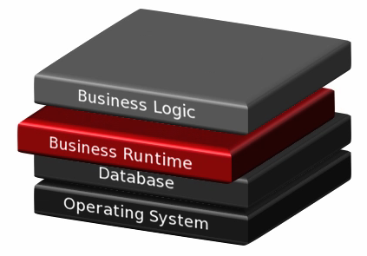
What “SAP Security” really is
SAP security is a complex discipline, that must be addressed holistically!
SoD controls are necessary, but they are not enough.
They only address one of the layers where security must be enforced.
The forgotten layer: The Business Infrastructure (NetWeaver/Basis).
Base framework in charge of critical tasks such as authentication, authorization, encryption, interfaces, audit, logging, etc.
Can be susceptible of security vulnerabilities that, if exploited, can lead to espionage, sabotage and fraud attacks to the business information.
Cyber-attacks on SAP Systems

Slide 12
A different (higher) risk profile
Exploitation of a SoD weakness:
The attacker needs a valid user account in the target SAP system.
He needs to find out that he has more access than he should have.
Common auditing features may detect his activities.
Exploitation of a technical/infrastructure weakness:
The attacker does not need a valid user account in the target SAP system.
A successful attack will allow him to achieve SAP_ALL privileges (even without having a real user!).
Common auditing features would not detect his activities.
Cyber-attacks on SAP Systems
Cyber-Attacks to SAP Systems

Slide 13
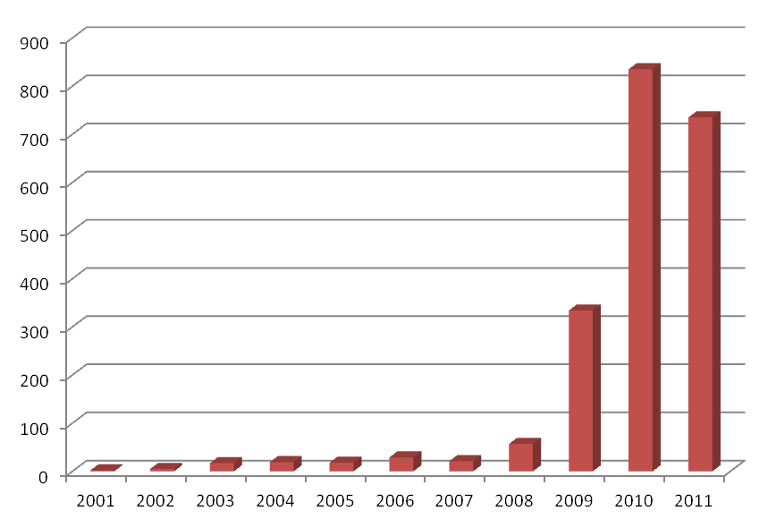
A Rising Threat
The number of SAP Security Notes has increased dramatically over the last years.
Security Notes usually address one or more vulnerabilities.
Most of these issues affect the Business Runtime.
Number of SAP Security Notes per Year
Total:
2068
Cyber-attacks on SAP Systems
Cyber-Attacks to SAP Systems

Slide 14
External and
Internal Threats
Cyber-attacks on SAP Systems

Slide 15
Querying search engines
While most SAP systems were only reachable internally a decade ago, now it’s common for SAP systems to be connected to the Internet.
Attackers know how to find them using regular search engines.
Cyber-attacks on SAP Systems

Slide 16
But… is it more than just Web apps?
Even if companies believe they are not online, many of them are!
When you acquire the SAP software license, the agreement specifies that you have to allow remote access through a special component called SAProuter.
Network services such as the Dispatcher, Gateway, Management Console, Message Server, P4 interface, etc. should never touch the Internet…
What’s the reality?
Cyber-attacks on SAP Systems

Slide 17
But… is it more than just Web apps?
The non-profit security research group Mateslab is analyzing the availability of SAP services in the Internet.
According to SHODAN, there are 45 systems with SAP Web servers in the Netherlands.
Based on Mateslab initial results, there are presumably at least 16 systems exposing the SAProuter to the Internet in the NL.
Work in progress to assess the entire Internet looking for ERP systems, understanding our current exposure.
Special thanks to Sebastian Garcia, Veronica Valeros
and Agustin Gugliotta for their amazing work.
Check out their dnmap project!
www.MatesLab.com.ar
Cyber-attacks on SAP Systems

Slide 18
- From the Trenches - The Current Security Level of SAP Implementations
Cyber-attacks on SAP Systems

Slide 19
From the trenches
Since 2005, our experts were engaged to perform numerous SAP Penetration Tests, including some of the largest organizations of the world.
We have evaluated more than 550 SAP Application Servers in total.
A typical project’s methodology and scope:
Network access to the regular end-user network segment.
Only a list of IP addresses of target SAP servers.
NO user/password credentials provided.
What have we learned?
Cyber-attacks on SAP Systems

Slide 20
Over 95% of the systems were exposed to espionage, sabotage and fraud attacks.

Slide 21
Only 5% of the evaluated SAP systems had the proper security audit logging features enabled.

Slide 22
None of the evaluated SAP systems were fully updated with the latest SAP security patches.

Slide 23
In most cases, the attack vectors that lead to the initial compromise resulted from the exploitation of vulnerabilities that have been publicly known for more than 5 years.

Slide 24
The TOP-11 vulnerabilities affecting the SAP infrastructure
Cyber-attacks on SAP Systems

Slide 25
BIZEC.org - The Business Application Security Initiative
BIZEC.org is a non-profit organization focused on security threats affecting ERP systems and business-critical infrastructure.
The BIZEC TEC/11 project lists the most common and most critical security defects and threats affecting the Business Runtime layer/infrastructure of SAP platforms.
Join & contribute! www.bizec.org
Cyber-attacks on SAP Systems

Slide 26
BIZEC TEC-01: Vulnerable Software in Use
Risk
The SAP platform is running based on technological frameworks whose versions are affected by reported security vulnerabilities and the respective fixes have not been applied.
Business Impact
Attackers would be able to exploit reported security vulnerabilities and perform unauthorized activities over the business information processed by the affected SAP system.
Cyber-attacks on SAP Systems

Slide 27
BIZEC TEC-02: Standard Users with Default Passwords
Risk
Users created automatically during the SAP system installation, or other standard procedures, are configured with default, publicly known passwords.
Business Impact
Attackers would be able to login to the affected SAP system using a standard SAP user account. As these accounts are usually highly privileged, the business information would be exposed to espionage, sabotage and fraud attacks.
Cyber-attacks on SAP Systems

Slide 28
BIZEC TEC-03: Unsecured SAP Gateway
Risk
The SAP Application Server’s Gateway is not restricting the starting, registration or cancellation of external RFC servers.
Business Impact
Attackers would be able to obtain full control of the SAP system. Furthermore, they would be able to intercept and manipulate interfaces used for transmitting sensitive business information.
Cyber-attacks on SAP Systems

Slide 29
BIZEC TEC-04: Unsecured SAP/Oracle authentication
Risk
The SAP ABAP Application Server authenticates to the Oracle database through the OPS$ mechanism, and the Oracle’s listener has not been secured.
Business Impact
Attackers would be able to obtain full control of the affected SAP system’s database, enabling them to create, visualize, modify and/or delete any business information processed by the system.
Cyber-attacks on SAP Systems

Slide 30
BIZEC TEC-05: Insecure RFC interfaces
Risk
The SAP environment is using insecure RFC connections from systems of lower security-classification level to systems with higher security- classification levels.
Business Impact
Attackers would be able to perform RFC pivoting attacks, by first compromising an SAP system with low security-classification and, subsequently, abusing insecure interfaces to compromise SAP systems with higher security-classification levels.
Cyber-attacks on SAP Systems

Slide 31
BIZEC TEC-06: Insufficient Security Audit Logging
Risk
The SAP System’s auditing features are disabled or not properly configured.
Business Impact
It would not be possible to detect suspicious activities or attacks against the SAP system. Furthermore, valuable information for forensic investigations would not be available.
Cyber-attacks on SAP Systems

Slide 32
BIZEC TEC-07: Unsecured SAP Message Server
Risk
The SAP System’s Message Server is not restricting the registration of SAP Application Servers.
Business Impact
Attackers would be able to register malicious SAP Application Servers and perform man-in-the-middle attacks, being able to obtain valid user access credentials and sensitive business information. Attacks against user workstations would also be possible.
Cyber-attacks on SAP Systems

Slide 33
BIZEC TEC-08: Dangerous SAP Web Applications
Risk
The SAP Application Server is allowing access to Web applications with reported security vulnerabilities or sensitive functionality.
Business Impact
Attackers would be able to exploit vulnerabilities in such Web applications, enabling them to perform unauthorized activities over the business information processed by the affected SAP system.
Cyber-attacks on SAP Systems

Slide 34
BIZEC TEC-09: Unprotected Access to Administration Services
Risk
The SAP Application Server is not restricting access to sensitive administration or monitoring services.
Business Impact
Attackers would be able to access administration or monitoring services and perform unauthorized activities over the affected SAP systems, possibly leading to espionage and/or sabotage attacks.
Cyber-attacks on SAP Systems

Slide 35
BIZEC TEC-10: Insecure Network Environment
Risk
The network environment of the SAP platform is not properly secured through the deployment and configuration of network firewalls, specialized Intrusion Prevention and Detection systems and application-layer gateways.
Business Impact
Attackers would be able to access sensitive SAP network services and possibly exploit vulnerabilities and unsafe configurations in them, leading to the execution of unauthorized activities over the affected SAP platform.
Cyber-attacks on SAP Systems

Slide 36
BIZEC TEC-11: Unencrypted Communications
Risk
The confidentiality and integrity of communications in the SAP landscape is not enforced. These communications comprise SAP-to-SAP connections as well as interactions between SAP servers and external systems, such as user workstations and third-party systems.
Business Impact
Attackers would be able to access sensitive technical and business information being transferred to/from the SAP environment.
Cyber-attacks on SAP Systems

Slide 37
Defending the SAP Platform
Cyber-attacks on SAP Systems

Slide 38
The Challenges
Knowledge. Understanding how to assess and secure an SAP system requires specialized knowledge.
Scope. The entire platform must be secured. This comprises:
Every Landscape (ERP, CRM, SCM, …) in the organization
Every SAP system in each landscape
Every Client (mandant) and App Server in each system
Every of the 1500+ configuration parameters of each App Server
Periodicity. The security of the SAP infrastructure must be evaluated periodically, at least after each SAP Security Patch Day, to verify whether new risks have been raised and evaluate necessary mitigation actions.
Cyber-attacks on SAP Systems

Slide 39
SAP Security - Who is responsible?
Unlike other systems (such as Web servers, domain controllers, etc.), the security of SAP systems usually falls under the domain of “The Business”.
This means that the officers in charge of securing the systems are the same ones who are responsible for verifying whether they are secure or not → FAIL!
If the organization's SAP teams are responsible for protecting the SAP platform, then the Information Security Manager / CISO’s department must verify whether the current security level matches the organization's defined risk appetite.
Cyber-attacks on SAP Systems

Slide 40
SAP Security - Who is responsible?
A few questions for you to understand where your Information Security team is today in regards to the security of your SAP systems:
Is the SAP platform a “blackbox” for the team? Are you not allowed to look at it? Why?
So you are trusting…but, do you “verify”?
Who will be ultimately responsible if there is a security breach in the SAP platform? What if they exploit a vulnerability known for 5 years?
What makes SAP so different, for you not to be in control of it?
Cyber-attacks on SAP Systems

Slide 41
Conclusions
Cyber-attacks on SAP Systems

Slide 42
Conclusions
Segregation of Duties controls are necessary, but not enough!
The SAP infrastructure can be exposed to technical security vulnerabilities that, if exploited, would enable espionage, sabotage and financial fraud attacks. The risk level in this matter is higher, as attackers do not even need a user account in the system!
The number of SAP security notes have dramatically increased over the last years. Customers are not catching-up.
Many companies state “our SAP system has not been hacked”, but they do not even have the basic auditing features enabled! How do they know?
Cyber-attacks on SAP Systems

Slide 43
Conclusions
Many SAP systems are connected to the Internet, and exposing sensitive services beyond Web applications. Furthermore, the internal network is usually not properly segmented.
SAP is taking important steps into increasing the security of its customers’ systems (security guides, regular patches, new standards).
While “The Business” may work on the security of the platform, it’s the responsibility of Information Security to verify that they are doing their job correctly.
If our business-critical infrastructure is hacked by exploiting a 5-year-old vulnerability, we are clearly doing something wrong.
Cyber-attacks on SAP Systems

Slide 44
Questions?
mnunez@onapsis.com
@marianonunezdc
Cyber-attacks on SAP Systems

Slide 45
Thank you!
www.onapsis.com
Follow us! @onapsis
Cyber-attacks on SAP Systems

